Slide 1


The Power of Big Data in Logistics
Big Data Analytics with Hadoop and Spark
SV
Ramniranjan Jhunjhunwala College
Shivam Vishwakarma

Slide 2
Understanding Logistics
What is Logistics?
Examples
Logistics is the process of managing the flow of goods, services, and information from point A to point B. This encompasses everything from supply chain management and warehousing to transportation and inventory control.
Think about how your online order is processed, from the moment you click “buy” to its arrival at your doorstep. Each step involves logistics, ensuring the smooth flow of goods and information.
Ramniranjan Jhunjhunwala College
Shivam Vishwakarma

Slide 3

Introducing Big Data
1
Definition
2
The 5 Vs
Big data refers to large, complex data sets that exceed the capabilities of traditional data processing tools.
Big data is characterized by its volume, variety, velocity, veracity, and value.
Ramniranjan Jhunjhunwala College
Shivam Vishwakarma

Slide 4
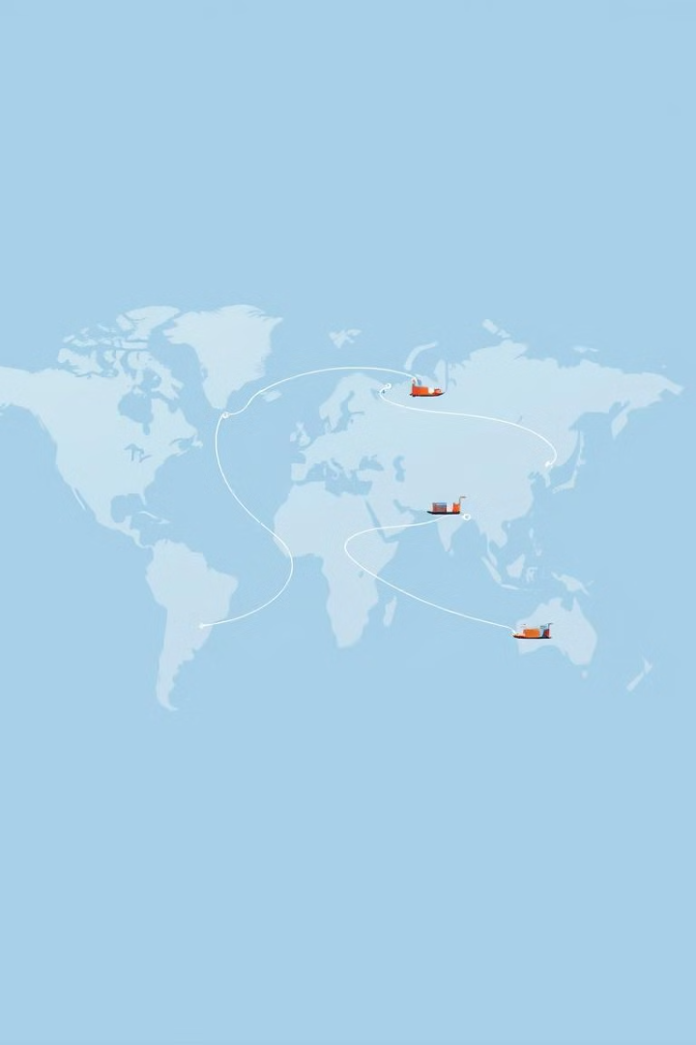



Big Data's Impact on Logistics
Data-Driven Decisions
Predictive Analytics
Real-Time Tracking
Big data provides real-time insights
Helps for making informed decisions on everything from
Optimization inventory management
Using historical data to predict future demand.
GPS and IoT sensors collect real-time data of location and condition of shipments.
Helps to provide transparency to both businesses and customers.
Ramniranjan Jhunjhunwala College
Shivam Vishwakarma

Slide 5

Key Technologies
IoT
Cloud Computing
Sensors and connected devices collect data on the condition, location, and movement of goods, providing real-time insights.
Allows for storage and processing of vast amounts of data remotely, facilitating real-time access and sharing.
AI & Machine Learning
Blockchain
Algorithms analyze data to predict trends, optimize routes, and improve logistics processes.
Ensures transparency, security, and accuracy in logistics data, streamlining operations and enhancing trust.
Ramniranjan Jhunjhunwala College
Shivam Vishwakarma

Slide 6
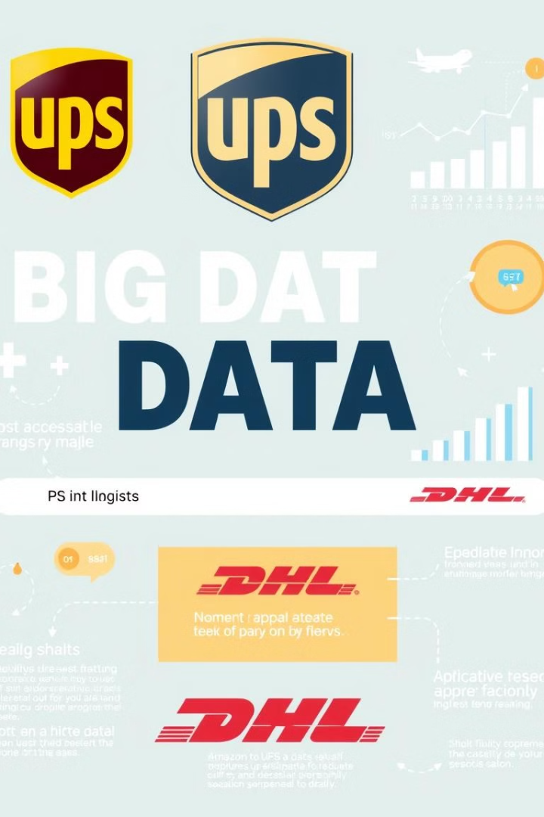
Real-World Examples
1
UPS
Uses big data analytics to optimize delivery routes, reduce fuel consumption, and improve efficiency across their vast network.
2
Amazon
Leverages big data for inventory management, predictive shipping, and personalized customer recommendations based on their behavior.
3
DHL
Employs big data to track shipments globally, analyze data to predict maintenance needs for vehicles and equipment, and streamline operations.
Ramniranjan Jhunjhunwala College
Shivam Vishwakarma

Slide 7





Challenges and Opportunities
Data Quality
Inaccurate or incomplete data can lead to poor decisions, emphasizing the need for data validation and cleansing.
Integration
Logistics companies often use different systems, making seamless integration of big data a complex task.
Implementation Cost
Implementing big data technologies can be expensive, requiring investment in infrastructure, software, and skilled personnel.
Data Security
Protecting sensitive customer and business data is paramount, requiring robust security measures and compliance with relevant regulations.
Ramniranjan Jhunjhunwala College
Shivam Vishwakarma

Slide 8

Future Trends
Sustainability
Autonomous Vehicles
Big data will play a crucial role in promoting sustainability in logistics by optimizing routes to reduce carbon emissions and minimizing waste.
Predictive and Prescriptive Analytics
Data is key to the development and deployment of self-driving trucks and drones, transforming delivery and logistics operations.
Automation
AI and robotics will continue to automate logistics operations, from warehousing and inventory management to delivery.
Moving beyond simply predicting trends to providing actionable insights for logistics management, optimizing operations and efficiency.
Ramniranjan Jhunjhunwala College
Shivam Vishwakarma

Slide 9
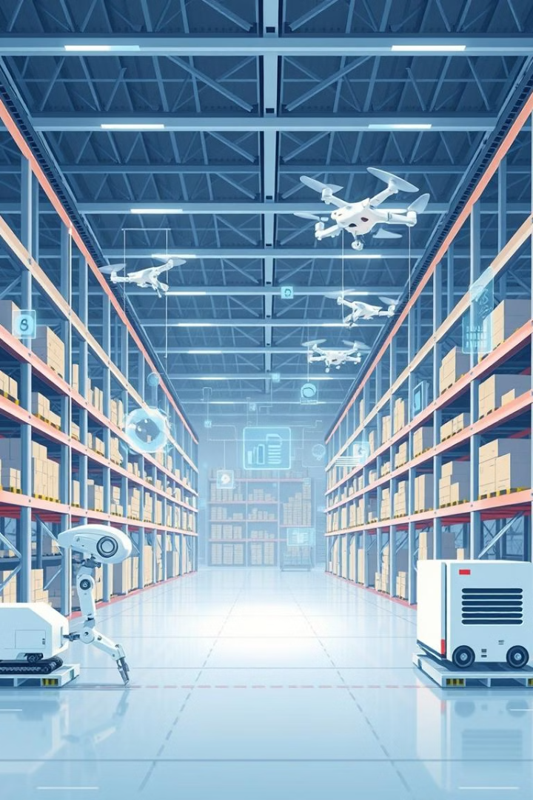
Conclusion
Big data is not just a trend; it's a fundamental force transforming logistics operations, leading to increased efficiency, cost savings, and improved customer experiences. The future of logistics promises even greater innovations, driven by big data and its ability to optimize every aspect of the supply chain.
Ramniranjan Jhunjhunwala College
Shivam Vishwakarma

Slide 10

THANK YOU
This presentation explored the role of big data in revolutionizing the logistics industry, from optimizing supply chains to enhancing customer experiences.
Ramniranjan Jhunjhunwala College
Shivam Vishwakarma

